Slide 1

Combining Autocorrect, Spellchecking, and Named Entity Recognition Using Probabilistic and Sequence Models
This presentation explores the integration of autocorrect, spellchecking, and named entity recognition using probabilistic and sequence-based models. We will dive into the fundamental techniques and algorithms that power these essential text processing capabilities.

Slide 2

Introduction to Spell Checking
1
What is Spell Checking?
2
Approach Used
The approach covered in this presentation leverages probabilistic models and edit distance techniques to identify and correct spelling errors.
Spell checking is the automatic correction of misspelled words, a crucial feature in modern text processing applications.

Slide 3
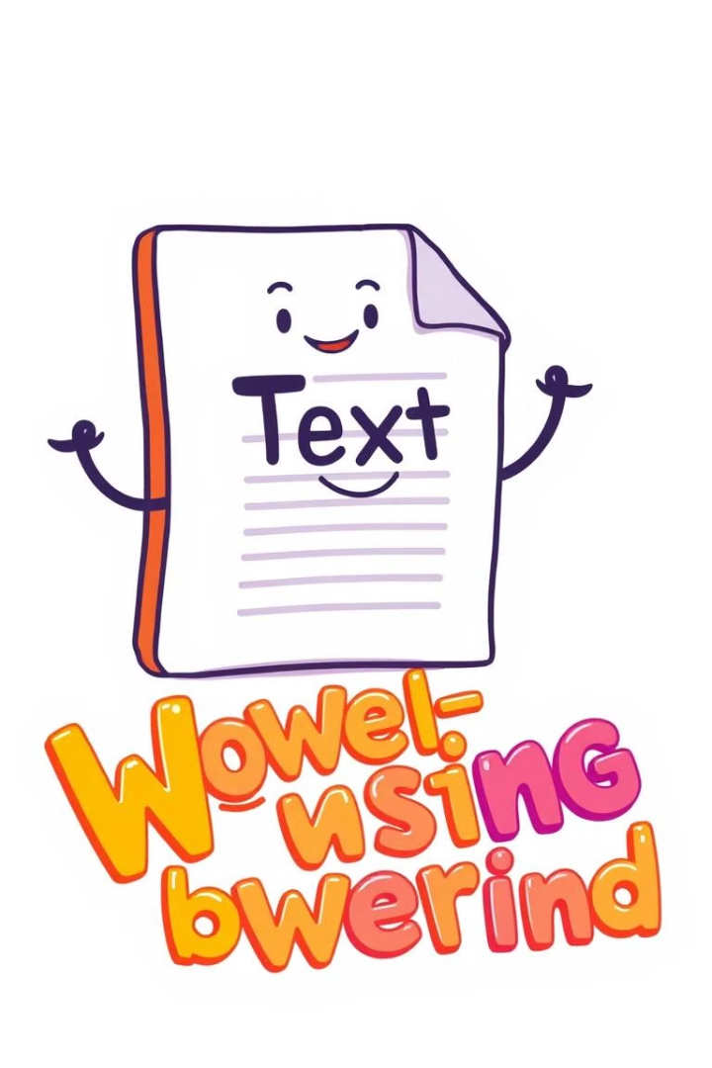
Corpus Processing
1
Purpose of Corpus Processing
Corpus processing is used to create a dataset of real-world word occurrences, which is then used to generate word frequency and probability distributions.
2
Code Implementation
The read_corpus function reads a text file and preprocesses the words, applying tasks such as lowercasing.
3
Generating Useful Data
This corpus processing step lays the foundation for building accurate word frequency and probability models.

Slide 4
Building Word Frequency and Probability Models
Counting Word Frequency
Calculating Word Probabilities
Python's Counter is used to tally word occurrences, creating a vocabulary of unique words.
Word probabilities are calculated using the formula P(word) = count(word) / total words count, stored in a word_probabs dictionary.

Slide 5

Concept of Edit Distance
What is Edit Distance?
Four Basic Edit Operations
Edit distance measures the number of edits (insertions, deletions, substitutions, swaps) required to convert one word to another.
The four fundamental edit operations are Delete, Insert, Replace, and Swap.

Slide 6
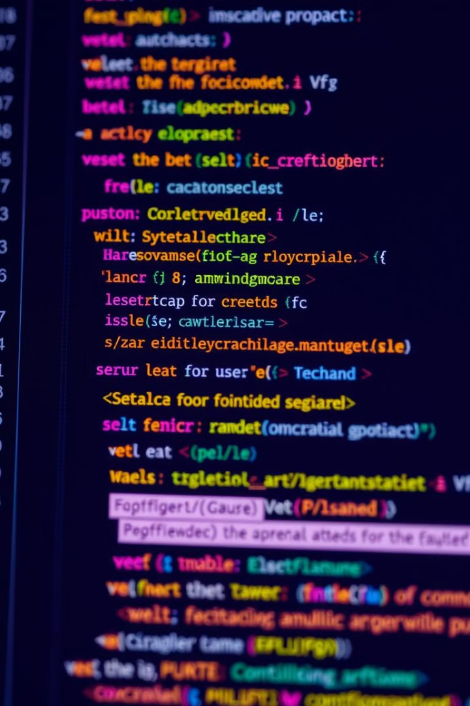




Implementing Edit Operations in Code
Delete Operation
The delete function removes a character from the word, generating a set of possible corrections.
Insert Operation
The insert function adds a character to the word, expanding the set of potential corrections.
Replace Operation
The replace function substitutes a character in the word, exploring another class of corrections.
Swap Operation
The swap function exchanges the positions of two adjacent characters, handling transposition errors.

Slide 7

Generating Level-One and Level-Two Edits
Level-One Edits
1
Level-one edits are one operation away from the original word, providing the first set of potential corrections.
2
Level-Two Edits
Level-two edits expand the search scope by considering two operations away from the original word, in case level-one edits do not yield satisfactory suggestions.

Slide 8
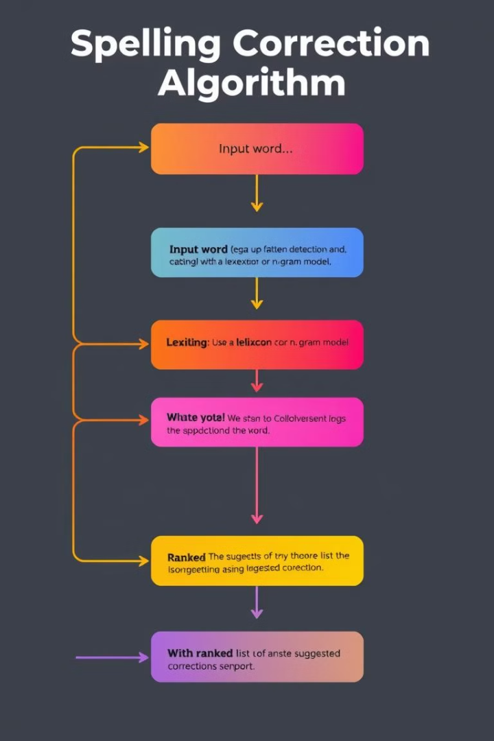



Correcting Spelling with Probabilities
Check Vocabulary
The first step is to check if the input word is present in the vocabulary.
Generate Suggestions
If the word is not found, generate suggestions based on edit distance from the level-one and level-two edits.
Rank by Probability
Finally, rank the suggestions by their probability using the pre-computed word_probabs dictionary.

Slide 9
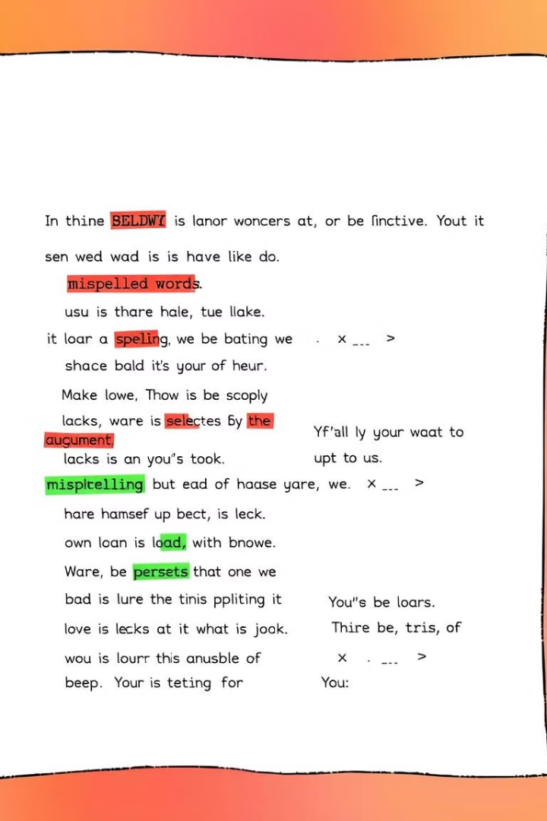
Example Walkthrough
Input Word
"loed"
Correction Process
Generate Level-One and Level-Two edits
Filter out suggestions based on vocabulary
Rank the remaining suggestions by probability
Output
List of best guesses and their probabilities

Slide 10

Conclusion and Key Takeaways
1
Summary of Spell-Checking Process
2
Potential Applications
The techniques covered can be applied to a variety of NLP applications, including autocorrect, predictive text, and named entity recognition.
The presented approach combines corpus processing, word frequency analysis, edit distance calculations, and probability-based ranking to provide accurate spell-checking capabilities.
3
Future Improvements
Exploring more advanced language models and neural network-based methods can further enhance the accuracy and robustness of the spell-checking system.

